Slide 1
Application of monte carlo search techniques on board games through go
Jack Malone

Slide 2
Background
Go is a difficult problem for more traditional algorithms that were used for other board games to.
I was interested in looking at different approaches that could be used instead of the traditional algorithms to be able to solve the game as well as new Reinforcement Learning models.

Slide 3
Motivation For Project
While I have created more simple AI for more basic games before for different projects in my course, I was interested in learning how to create an AI that would be able to solve a more difficult environment.

Slide 4
Objectives for Project
Implement Monte Carlo Tree Search and compare it to Alpha Beta Tree search.
Implement a deep q learning model
Implement a proximal policy optimisation model

Slide 5
Methodology
Methods used for this Project:
Monte Carlo Tree Search:
This algorithm allows for it to be interupted at any time and still be able to give an estimation on a good move. it is also quicker to be able to search through the search space.

Slide 6
Alpha Beta Tree Search
This was used as a benchmark and as one of the more traditional algorithms
Faster than regular MiniMax so has slight advantage over other algorithms

Slide 7
Deep Q learning
Good reinforcement learning model that is able to to learn without human input
uses a neural network for updating q values
can take time to train properly

Slide 8
Proximal Policy Optimisation
Good for making sure that the policy is not updated too much between training sessions
good for go as this means that having different games will not massively affect the outcome of the model

Slide 9
Experiments
The first experiment that I did was comparing the number of moves that both the Monte Carlo Tree Search and Alpha Beta Search were able to complete for each move for different sizes of boards.
The results were that the Monte Carlo Tree search had a big advantage the larger the board got.
graphs on next slides.

Slide 10
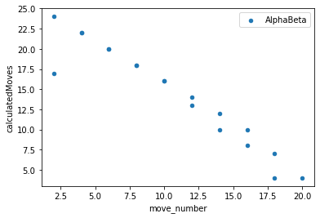
Alpha Beta small board

Slide 11
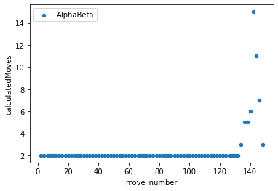
Alpha Beta Medium board

Slide 12
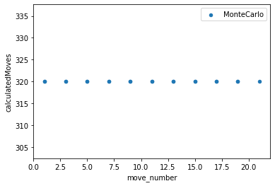
Monte Carlo Tree Search Small Board

Slide 13
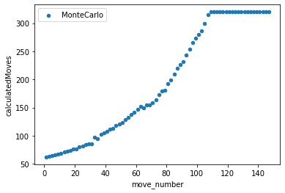
Monte Carlo Tree Search Medium Board

Slide 14
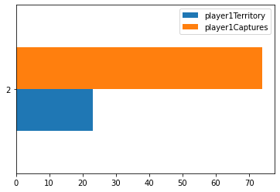
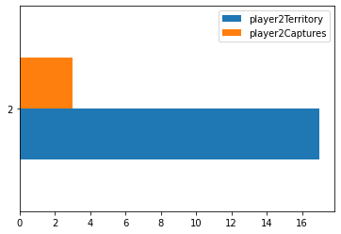
Difference in points

Slide 15
PPO vs. Deep Q learning
PPO was able to start being able to play pseudo-random moves after approximately 32,000 timesteps of training.
I trained the deep q learning model for 600 games of 500 steps for approximately 5 hours. This resulted in it still making invalid moves, showing that it was possibly overfitting

Slide 16
Conclusion
Monte Carlo Tree Search is a far better algorithm compared to Alpha Beta Tree Search if you have a large search space, however Alpha Beta would still be good for situations where it has the time/memory necessary to fully complete.
the version of PPO used was a lot better than the deep q learning model. If the deep q learning model was trained on only being able to play valid moves however I think that it could improve a lot given enough time to train.
Tradeoff between training time and time to pick a move.

